Slide 1

SMART PLUG
EDUCATIONAL DIY KIT

Slide 2
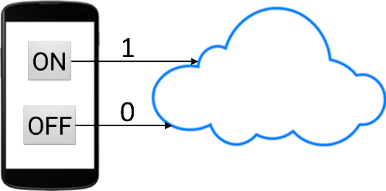
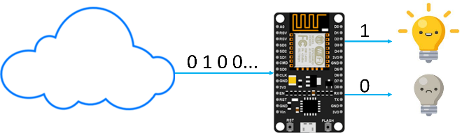
About the Kit
DIY Home Automation Kit
Key Features:
Remotely control any appliance using an app
No batteries required
How does the system work?
When the user presses a button on the app, data is sent by the app and is stored on the cloud. Value 1 is sent if ON button is pressed and value 0 is sent if OFF button is pressed.
NodeMCU on the kit constantly reads data from the cloud. If it reads value 1 from the cloud, it switches ON the relay which turns the appliance ON. If the NodeMCU reads value 0 from the cloud, it switches OFF the relay which turns OFF the appliance.

Slide 3
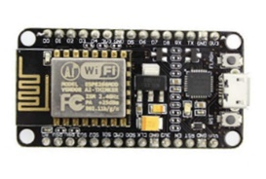
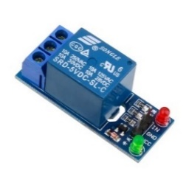
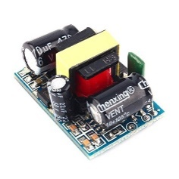
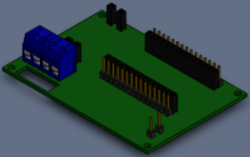
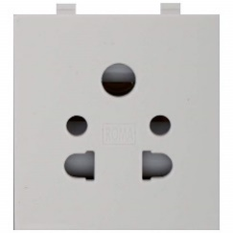
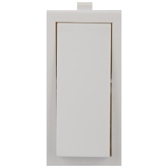
LIST OF COMPONENTS
COMPANY PORTFOLIO
NodeMCU x1
Single Channel Relay Module x1
AC to DC 5v Converter x1
PCB x1
Socket x1
Switch x1
Plug x1
USB Cable x1
Left Side Plate x1
Right Side Plate x1
Back Plate x1
Front Plate x1
Top Plate x1
Bottom Plate x1
Partition x1
Nuts and Bolts x80
Jumper Wires
Wires

Slide 4

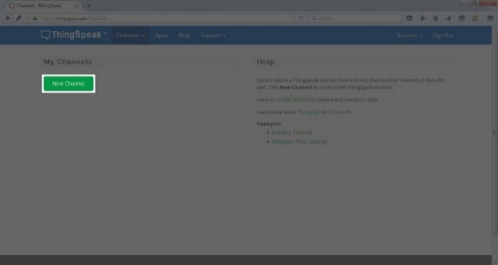
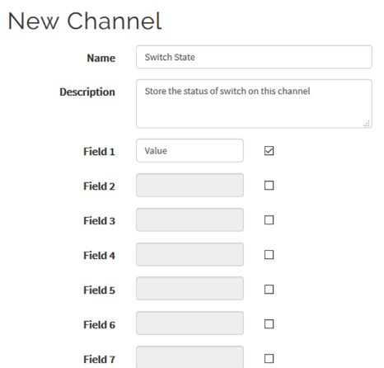
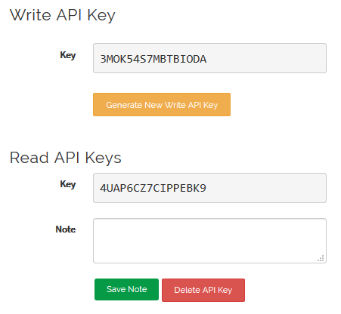
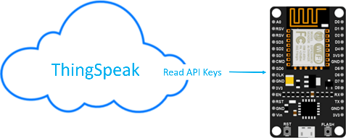
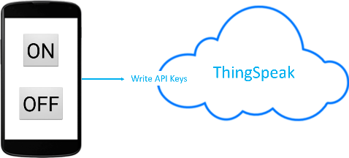
STEP 1 >> LOG IN THINGSPEAK
CLOUD BASED DATA BASE SET UP
COLLECT | ANALYSE | ACT ON IOT DATA
CREATE AN ACCOUNT
https://www.thingSpeak.com/
STEP 2 >> CREATE A NEW CHANNEL
TO STORE AND RETRIEVE DATA
Save the channel after filling in the details.
(Name, Channel 1)
STEP 3 >> ACCESS API KEYS
API WRITE KEY ALLOWS DATA TO BE WRITTEN
API READ KEY ALLOWS DATA TO BE READ

Slide 5
APP CREATION
FLOW CHART
STEP 1 : APP CREATION
www.ai2.appinventor.mit.edu
Click create app
STEP 2 : NEW PROJECT
Name the project
“Smart Plug ”
STEP 3 : FRONT END
Drag Button
Rename to ON / OFF
STEP 4 : ADD WEB CONNECTIVITY
Add when Button1. Click Do …
Http “API Key “
STEP 5 : Install APP
App is ready to install

Slide 6


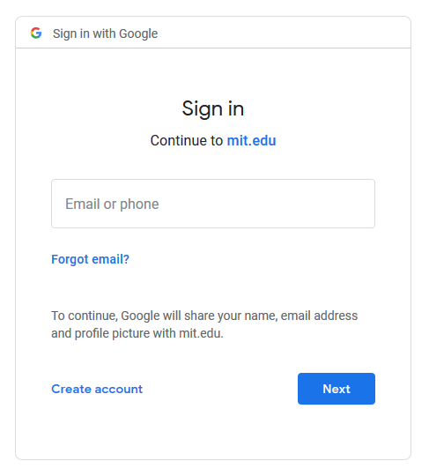
APP CREATION
COMPANY PORTFOLIO
STEP 1 : App creation
Step 1.1: Go to ai2.appinventor.mit.edu
And click “Create Apps”
Step 1.2 : A google sign will be required to create an app.
Use your GMAIL ID or create a new one.

Slide 7
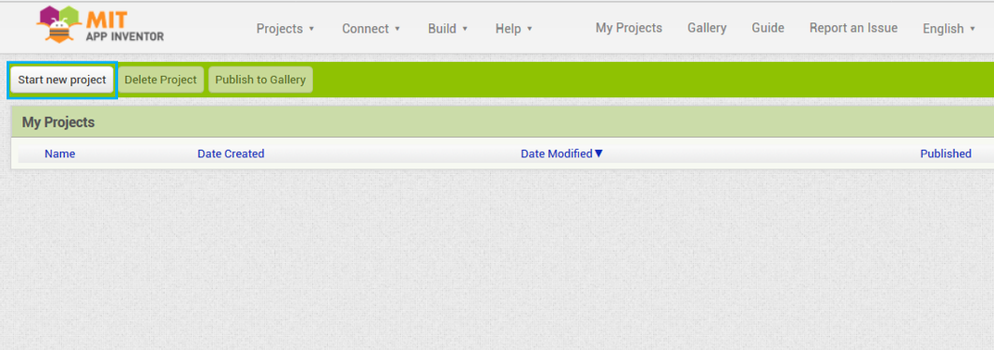
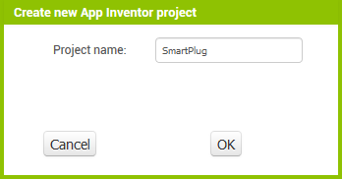
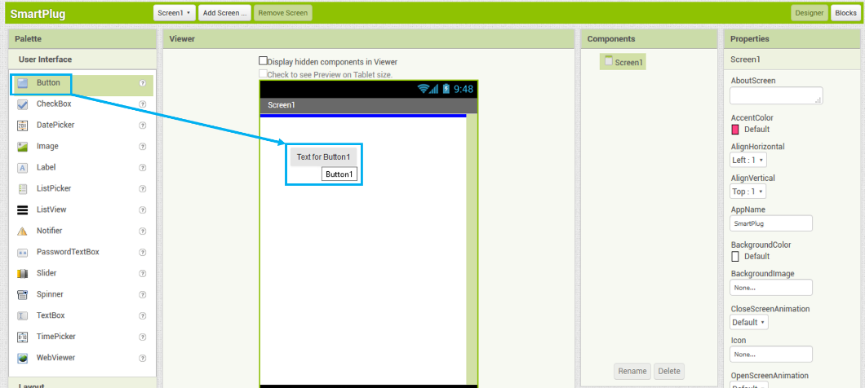
APP CREATION
COMPANY PORTFOLIO
STEP 2 : New Project
Step 2.1: Click on the “Create Project” button.
Step 2.2: Name your project “ Smart Plug”
STEP 3 : Front End Design
Step 3.1: Drag a button

Slide 8
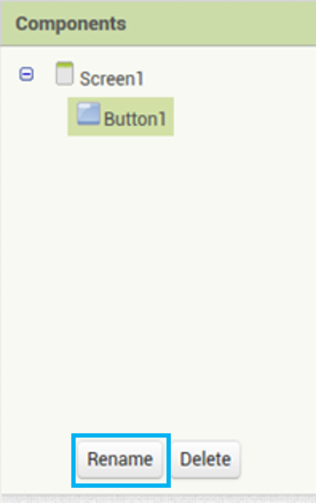
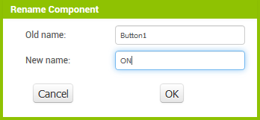
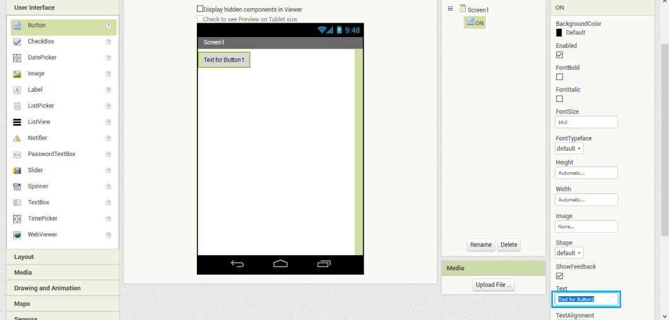
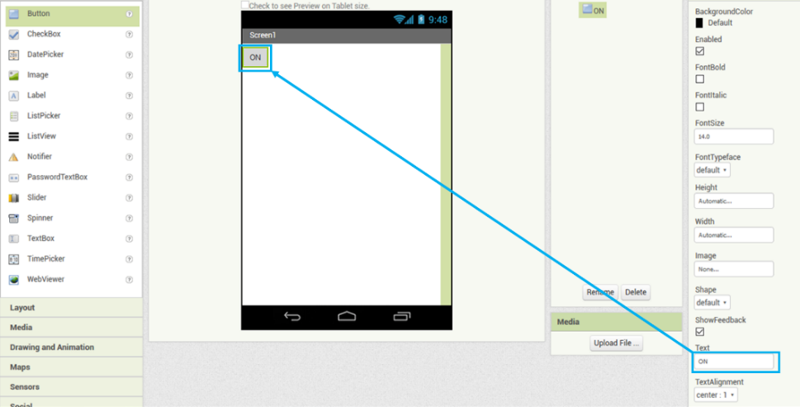
APP CREATION
COMPANY PORTFOLIO
Step 3.2 : Rename it to “ON”. This will change its name on the backend side of the app
Step 3.3 : Rename the name on Frontend side too.
Step 3.4 : Similarly, add another button and change its name to “OFF” on both backend and frontend side

Slide 9
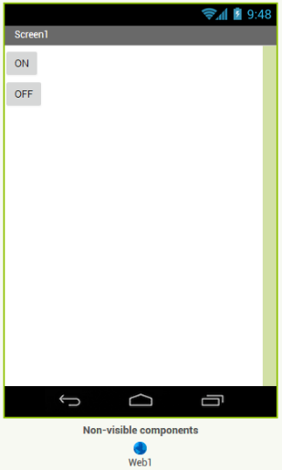
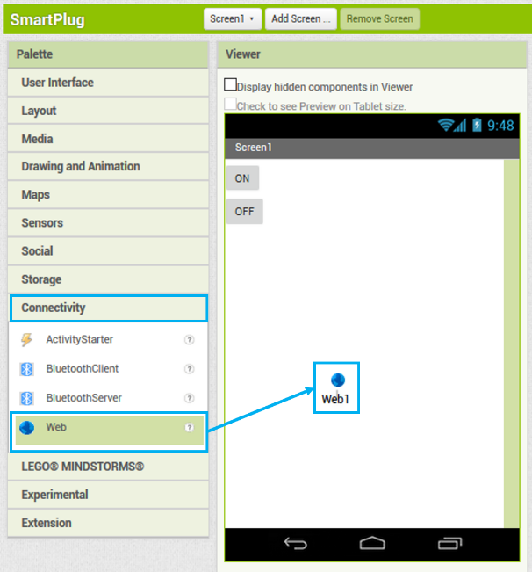
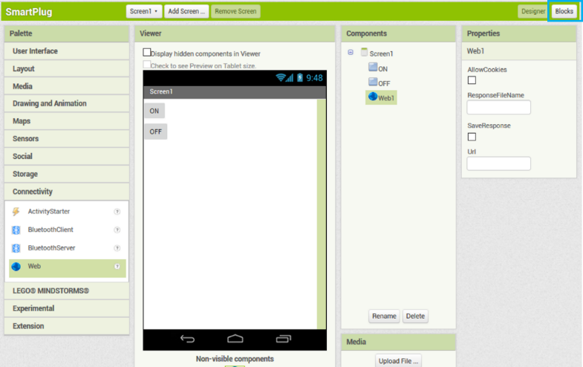
APP DESIGN
COMPANY PORTFOLIO
Step 3.5 : Add web component to the screen from the “Connectivity” Palette
Step 4 : WEB CONNECTIVITY
Step 4.1: Drag the web component from the “Connectivity” Palette

Slide 10
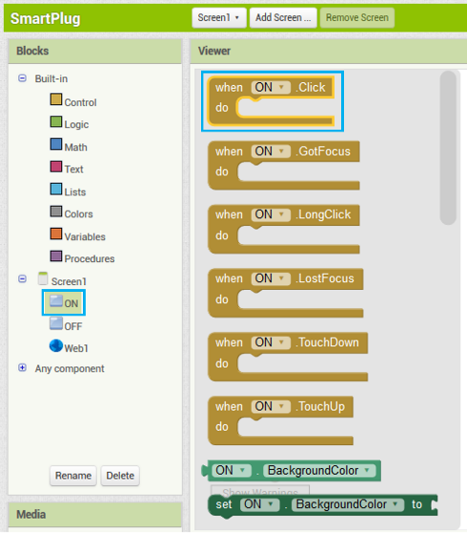
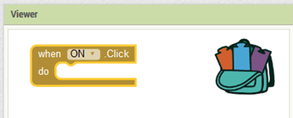
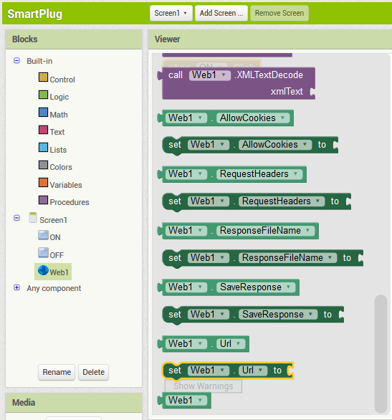
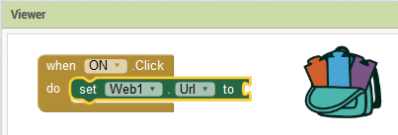
APP DESIGN
COMPANY PORTFOLIO
Step 4.2 : From the “ON” button drawer, select “when Button1.Click do” block and drag it in the workspace.
Step 4.3 : Add a “set Web1.Url” block and connect it to the “when Button1.Click do” block

Slide 11
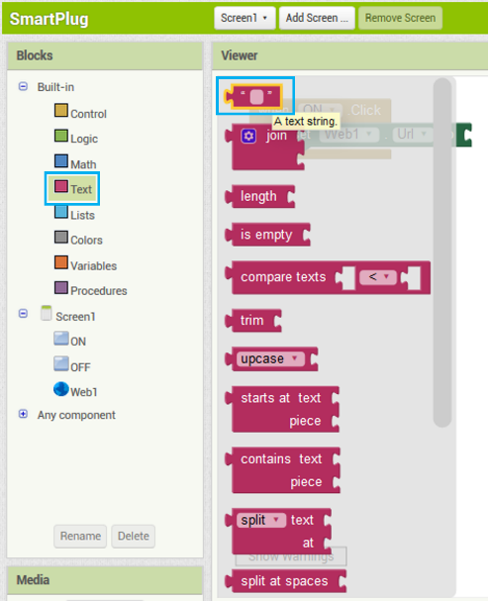
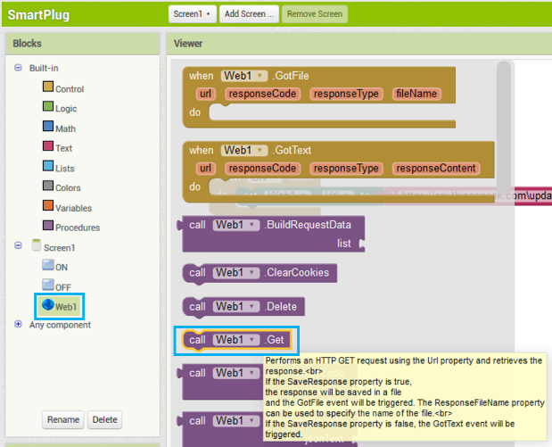
APP DESIGN
COMPANY PORTFOLIO
Step 4.4: Add a “text string” block and connect it to “set Web1.Url” block
Step 4.5: In the text block, write the following:
https://api.thingspeak.com/update?api_key=3MOK54S7MBTBIODA&field1=1
In place of the word “3MOK54S7MBTBIODA”, write the WRITE API KEY of your own ThingSpeak channel.
Step 4.6: Add a “call.Web1.get” block to send the http request.

Slide 12
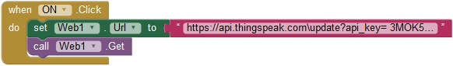
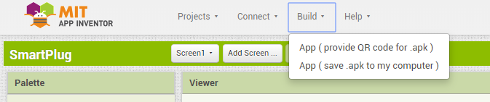
APP DESIGN
COMPANY PORTFOLIO
Step 4.7: This means that every time you click the “ON” button, the web URL will be set to https://api.thingspeak.com\update?api_key=3MOK54S7MBTBIODA &field1=1 and a value of 1 will be sent to the ThingSpeak channel at field1.
Do the same for OFF button. However, a value of 0 will be sent to ThingSpeak instead of 1. The web URL will thus be:
https://api.thingspeak.com\update?api_key=3MOK54S7MBTBIODA&field1=0
In place of “3MOK54S7MBTBIODA”, write the WRITE API KEY of your own ThingSpeak channel.
Step 5: Install the app
Step 5.1: After completing all the step, click on the “App( provide QR code .apk)”.
Now scan the QR code from your smartphone, it will download the apk to your phone’s local storage.
Now install it, and now your app is ready to control your home appliances

Slide 13
CODE UPDATE
FLOW CHART
STEP 1 : SET UP TUNIOT
http://easycoding.tn/TUNIOT/demos/code/
STEP 2 : WIFI CONNECTIVITY
Enter Wi-Fi Name and Password
STEP 3 : CONNECT TO CLOUD
Procure data from Thing Speak
STEP 4 : CONDITIONAL PROGRAM
Complete Logical Programming
STEP 5 : COPY TO ARDUINO IDE
Copy code to Arduino IDE
STEP 6 : CONNECT TO NODE MCU DEV KIT
Add ESP to Arduino IDE
Select Com Port
STEP 7 : UPLOAD CODE
Upload code to Node MCU

Slide 14
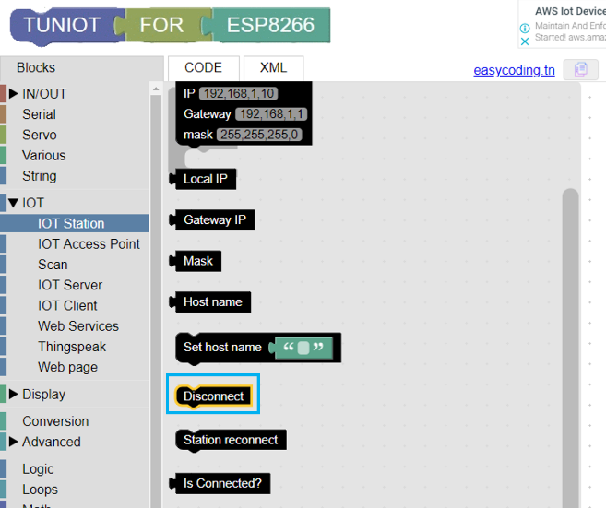
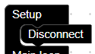
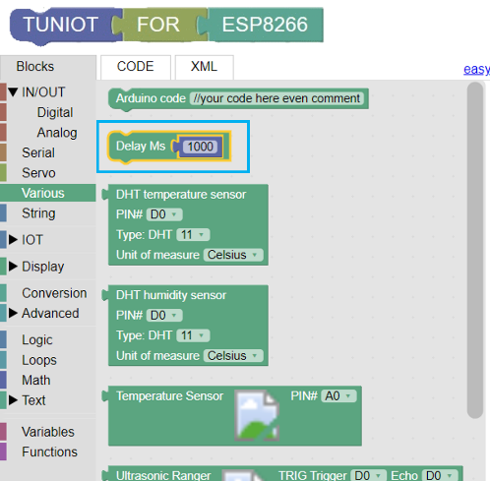
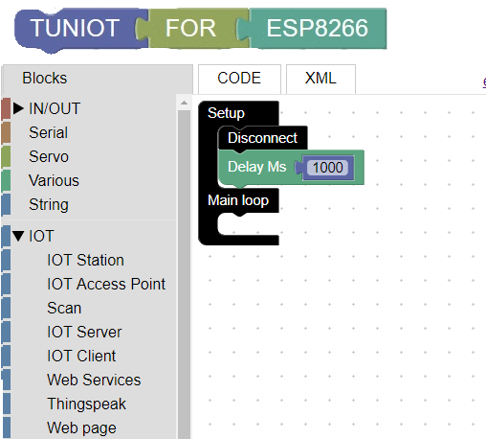
CODE DESIGN – Node MCU
http://easycoding.tn/TUNIOT/demos/code/
First we’ll work on the setup block as it’ll run only once and initialize the NodeMCU
STEP 1 : SET UP TUNIOT
Step 1.1: First place the “Disconnect” block in the setup block.
Step 1.2: Give one second delay using the “Delay” block

Slide 15
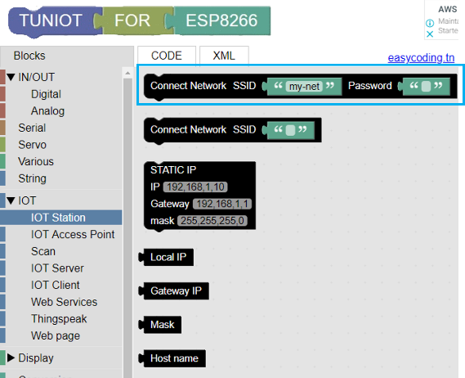
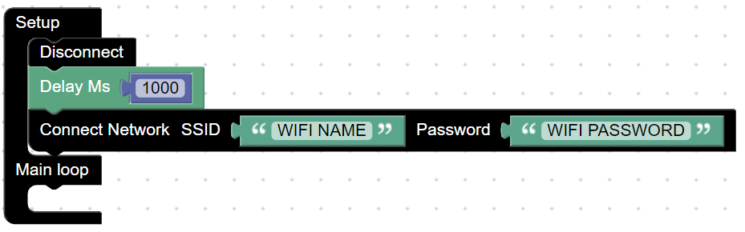
CODE DESIGN – Node MCU
COMPANY PORTFOLIO
STEP 2 : WIFI CONNECTIVITY
Step 2.1: “Connect Network” block tell the NodeMCU to connect to the Wi-Fi whose details are being entered in the SSID and Password field

Slide 16
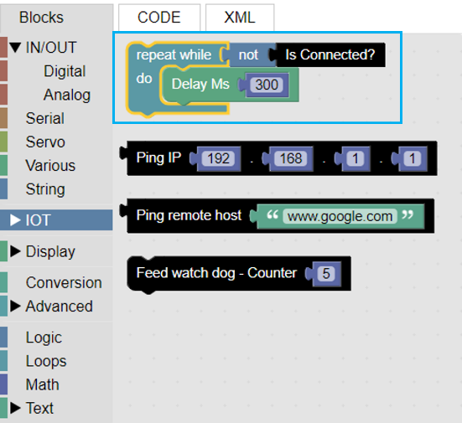
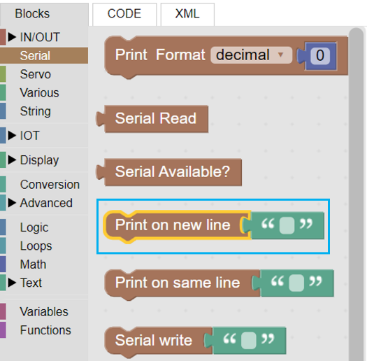
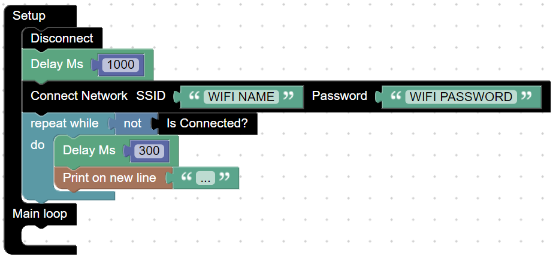
CODE DESIGN – Node MCU
COMPANY PORTFOLIO
Step 2.2: Now a “repeat while” block is used to wait till the Wi-Fi is connected. And for our reference a dot (.) is being printed every 300ms

Slide 17
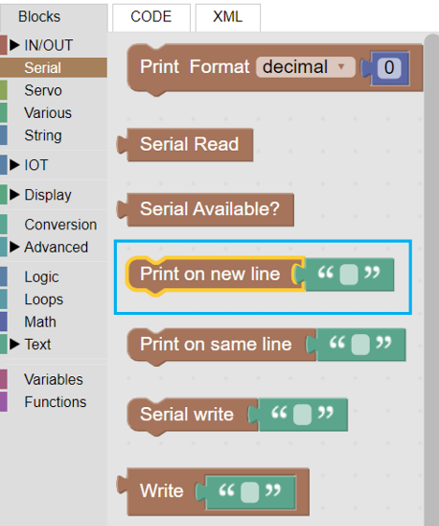
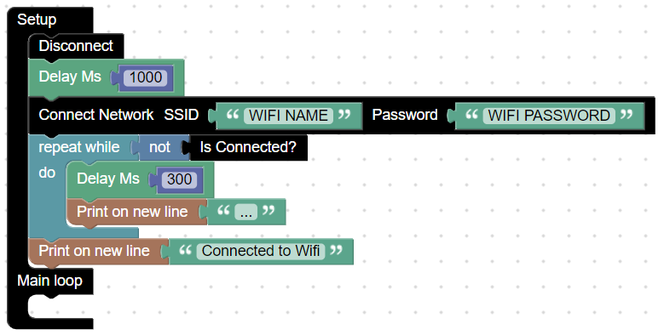
CODE DESIGN – Node MCU
COMPANY PORTFOLIO
Step 2.3: The loop will be exit as soon as the Wi-Fi is connected and a text will be printed to let us know the same using the “Print on new line” block

Slide 18
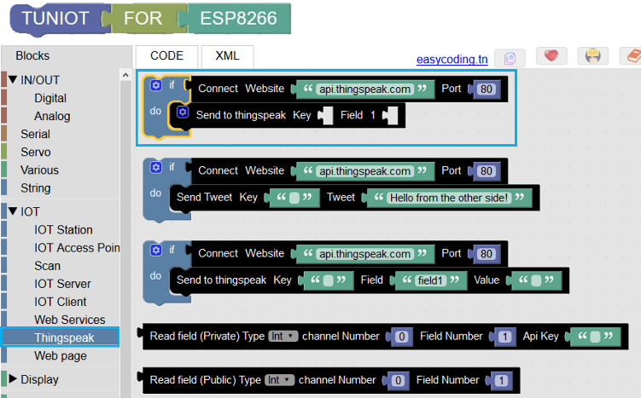
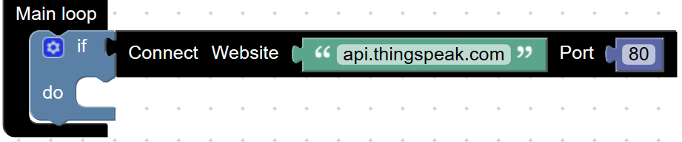
CODE DESIGN – Node MCU
COMPANY PORTFOLIO
STEP 3 : CONNECT TO CLOUD
Step 3: Use the “Connect Network” block to connect to the ThingSpeak website and procure data

Slide 19
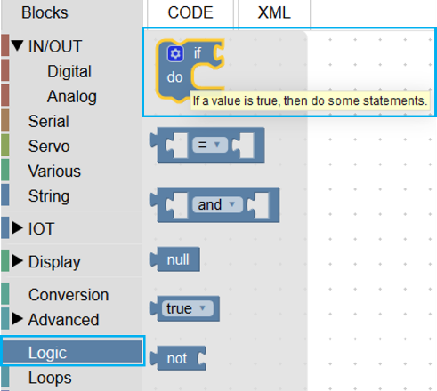
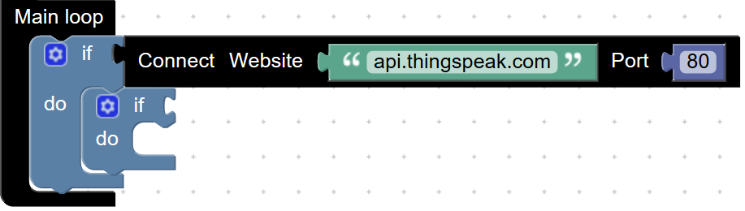
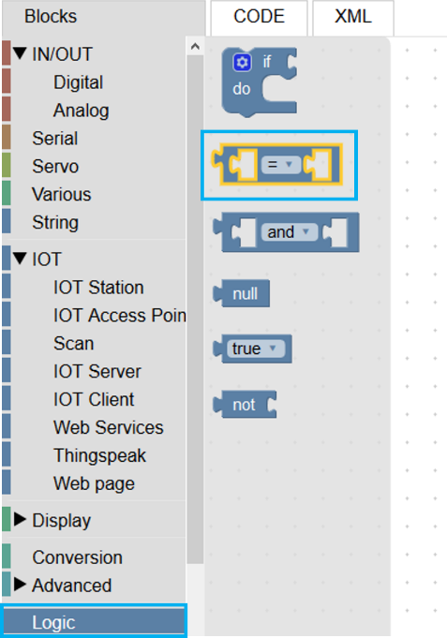
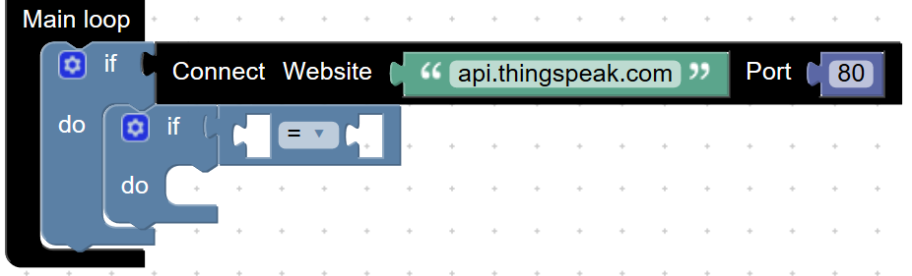
CODE DESIGN – Node MCU
COMPANY PORTFOLIO
STEP 4 : CONDITIONAL PROGRAM
Step 4.1: Use the “if-do” block to make some conditional logic programming. This will be used to check the value of the ThingSpeak channel and power ON/OFF the relay module accordingly.

Slide 20
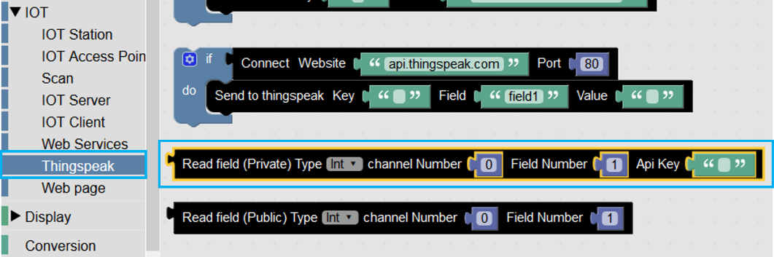



CODE DESIGN – Node MCU
COMPANY PORTFOLIO
Step 4.2: Enter the ThingSpeak details like API key and channel number in the “Read field” block.

Slide 21



CODE DESIGN – Node MCU
COMPANY PORTFOLIO
Step 4.3: Use “DigitalWrite” block to control the relay (i.e. HIGH/LOW). Here “D1” means the pin no “D1” on the NodeMCU

Slide 22




CODE DESIGN – Node MCU
COMPANY PORTFOLIO
STEP 5 : COPY TO ARDUINO IDE
Step 5.1 : Copy the code from TUNIOT by clicking on the copy button.

Slide 23

CODE DESIGN – Node MCU
COMPANY PORTFOLIO
Step 5.2 : Paste the copied code in the Arduino IDE

Slide 24
CODE DESIGN – Node MCU
COMPANY PORTFOLIO
#include <ESP8266WiFi.h>
#include <ThingSpeak.h>
WiFiClient client;
void setup()
{
Serial.begin(9600);
ThingSpeak.begin(client);
pinMode(16, OUTPUT);
WiFi.disconnect();
delay(1000);
WiFi.begin("WIFI NAME", "WIFI PASSWORD");
while ((!(WiFi.status() == WL_CONNECTED)))
{
delay(300);
Serial.println("...");
}
Serial.println("Connected to Wifi");
}
void loop()
{
if (client.connect("api.thingspeak.com", 80)) {
if ((ThingSpeak.readIntField(12345, 1, "API KEY")) == 1)
{
digitalWrite(16, LOW);
} else if ((ThingSpeak.readIntField(12345, 1, "API KEY")) == 0)
{
digitalWrite(16, HIGH);
}
}
}

Slide 25



ASSEMBLY
COMPANY PORTFOLIO
STEP 6 : CONNECT TO NODE MCU DEV KIT
Step 6.1: Add ESP8266 board in the Arduino IDE, as Arduino doesn’t have it by default.
Go to File >> Preferences >> Settings
In the “Additional Board Manager URLs” field add
http://arduino.esp8266.com/stable/package_esp8266com_index.json
Step 6.2: Now go to Tools >> Boards >> Board Manager and install the ESP8266 board.

Slide 26




ASSEMBLY
COMPANY PORTFOLIO
Step 6.3: Upload the code to the NodeMCU board
Make sure you’ve selected the Board as “Node MCU 1.0” and COM Port

Slide 27
MECHANICAL ASSEMBLY
FLOW CHART
STEP 1 : MOUNT PCB
Fix on base plate
Make connections
STEP 2 : ASSEMBLE
Fix Base First
Assemble
STEP 3 : PLUG CONNECTIONS
Assemble Plug
Switches
STEP 4 : RELAY CONNECTIONS
Complete Relay Connections
STEP 5 : POWER UP
Test

Slide 28


ASSEMBLY
COMPANY PORTFOLIO
STEP 1 : MOUNT PCB
Step 1.1: Fix PCB on base plate
Step 1.2: Make connections
Make the connections as shown in the circuit diagram

Slide 29




ASSEMBLY
COMPANY PORTFOLIO
STEP 2 : ASSEMBLY
Step 2.1: Place all the panels in its place.

Slide 30



ASSEMBLY
Step 2.2: Final output should be same as it is shown in the figure
Step 3: Plug Connections: Step 3.1: Connect the red and black wires from the plug to the screw terminals marked Live and Neutral.
Step 3.2: Switch Connections
Connect one end of the Switch to the screw terminal marked “Live”.
Connect the other end of the screw terminal to the end of the socket marked “L”.

Slide 31


ASSEMBLY
COMPANY PORTFOLIO
Step 4: Relay Connections Step 4.1: Output Side
Connect “NO” terminal of the Relay to the screw terminal marked “Neutral”.
Connect “COM” terminal of the Relay to the end of the socket marked “N”.
Step 4.2: Control Side
Connect the “Vcc” pin of Relay to the pin adjacent to it marked “Vcc”.
Connect pin “D1” of NodeMCU to the Relay module pin marked “IN”.

Slide 32
ADDITIONAL RESOURCES
COMPANY PORTFOLIO
Mentornet Resources
Link
Contact us
Articles to read
CERTIFICATE
COMPANY PORTFOLIO

